Slide 1
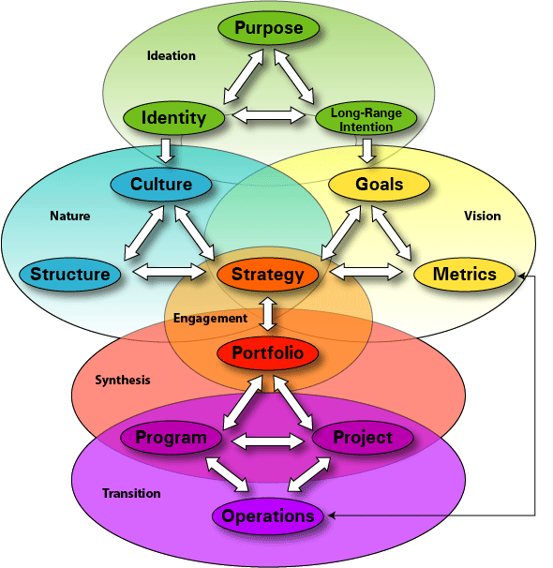
Strategic Execution Framework®

